Slide 1
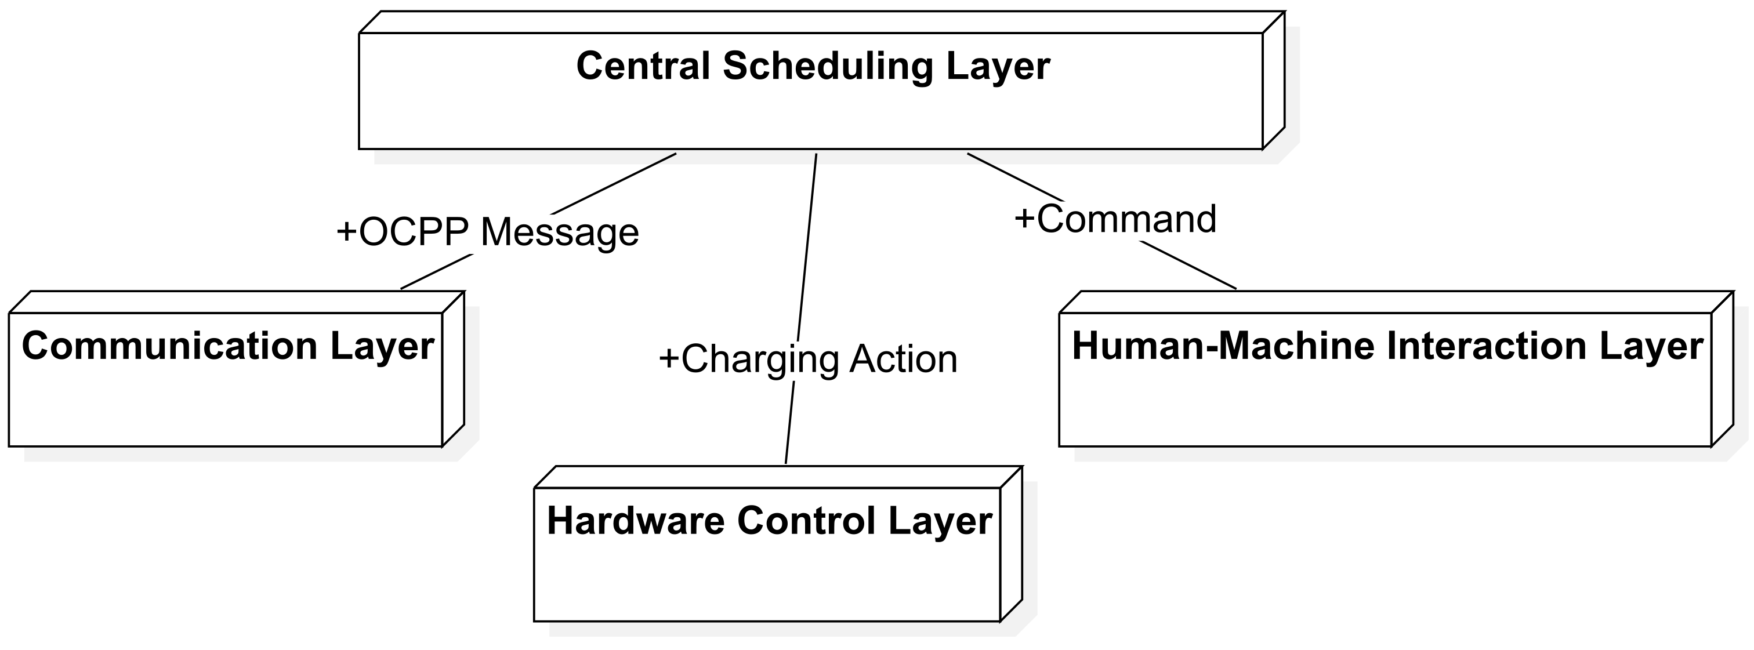
System structure
Notes:
Now, I will introduce the system structure of the charging station.
In this project, the system has four main layers: Communication Layer, Hardware Control Layer, Human-Machine Interaction Layer, and Central Scheduling Layer.

Slide 2
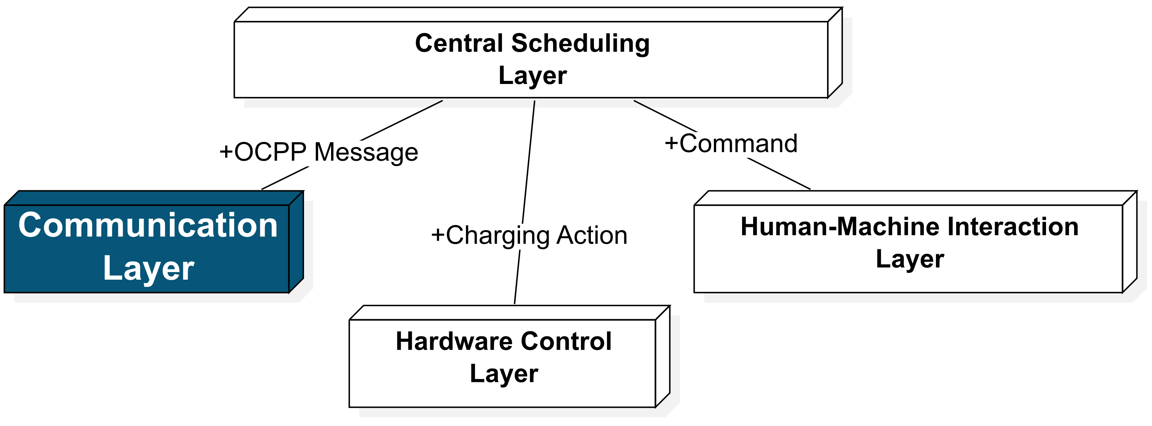
System structure——OCPP
Communication method:
WebSocket, used by OCPP officially
Execute type:
WebSocket: Asynchronously
OCPP-Library: Asynchronously
Message handle: Synchronously
Problem:
Low Concurrency
Optimizer: not support high concurrency
Charging Station: little influence
Low Scalability
message parsing and action execution are tied together
Solution:
signal-driven architecture to decouple
Notes:
Let's start with the Communication Layer. The main communication method is WebSocket, which is used by OCPP officially. WebSocket can receive messages asynchronously, so it doesn't block the thread. But because the official library handles messages synchronously, it cannot support high concurrency. This is a problem for the optimizer, but it has little impact on the charging station. Also, because message parsing and action execution are tied together, it has poor scalability. To solve this, we use a signal-driven architecture to improve scalability.
How does the communication work?

Slide 3
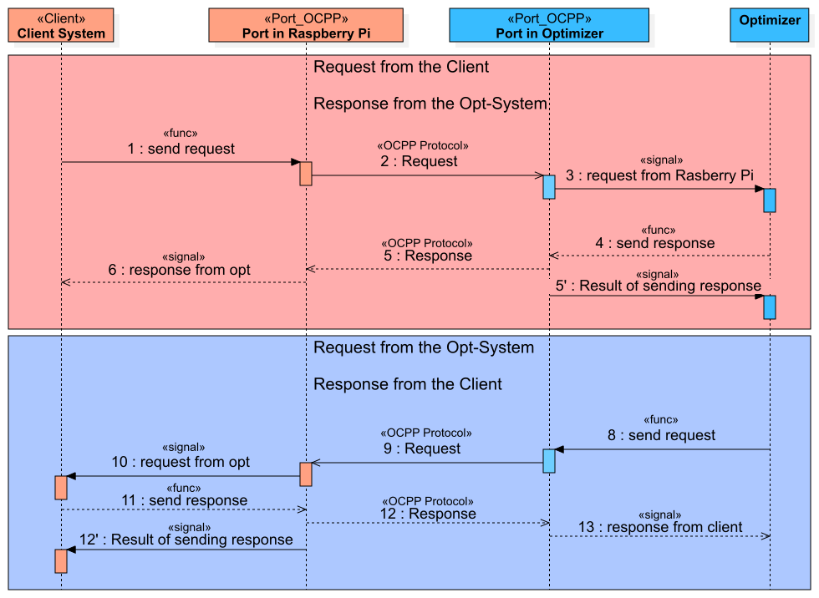
System structure——OCPP
Request: import information
Response: confirm receipt
Notes:
Let's look at this diagram.
When we send a request to the optimizer, we first call a function to send the request. The charging station waits for a response from the optimizer. When the optimizer responds, the charging station parses the response and sends the message using signals. If the optimizer takes too long to respond, a signal will notify the system of a timeout. In this case, the charging station will receive a timeout error. The process is the same when the optimizer sends a request to the charging station. In general, important information is in the Request, and the Response is only for confirming receipt.

Slide 4
System structure——OCPP
00
Notes:
OCPP messages are complex, with deep nesting and many links. To make this easier, we designed a message generator. Developers can call a function, and the IDE will show parameter hints. This way, developers don’t need to switch between the standard file and the code. It is efficient and reduces mistakes.

Slide 5
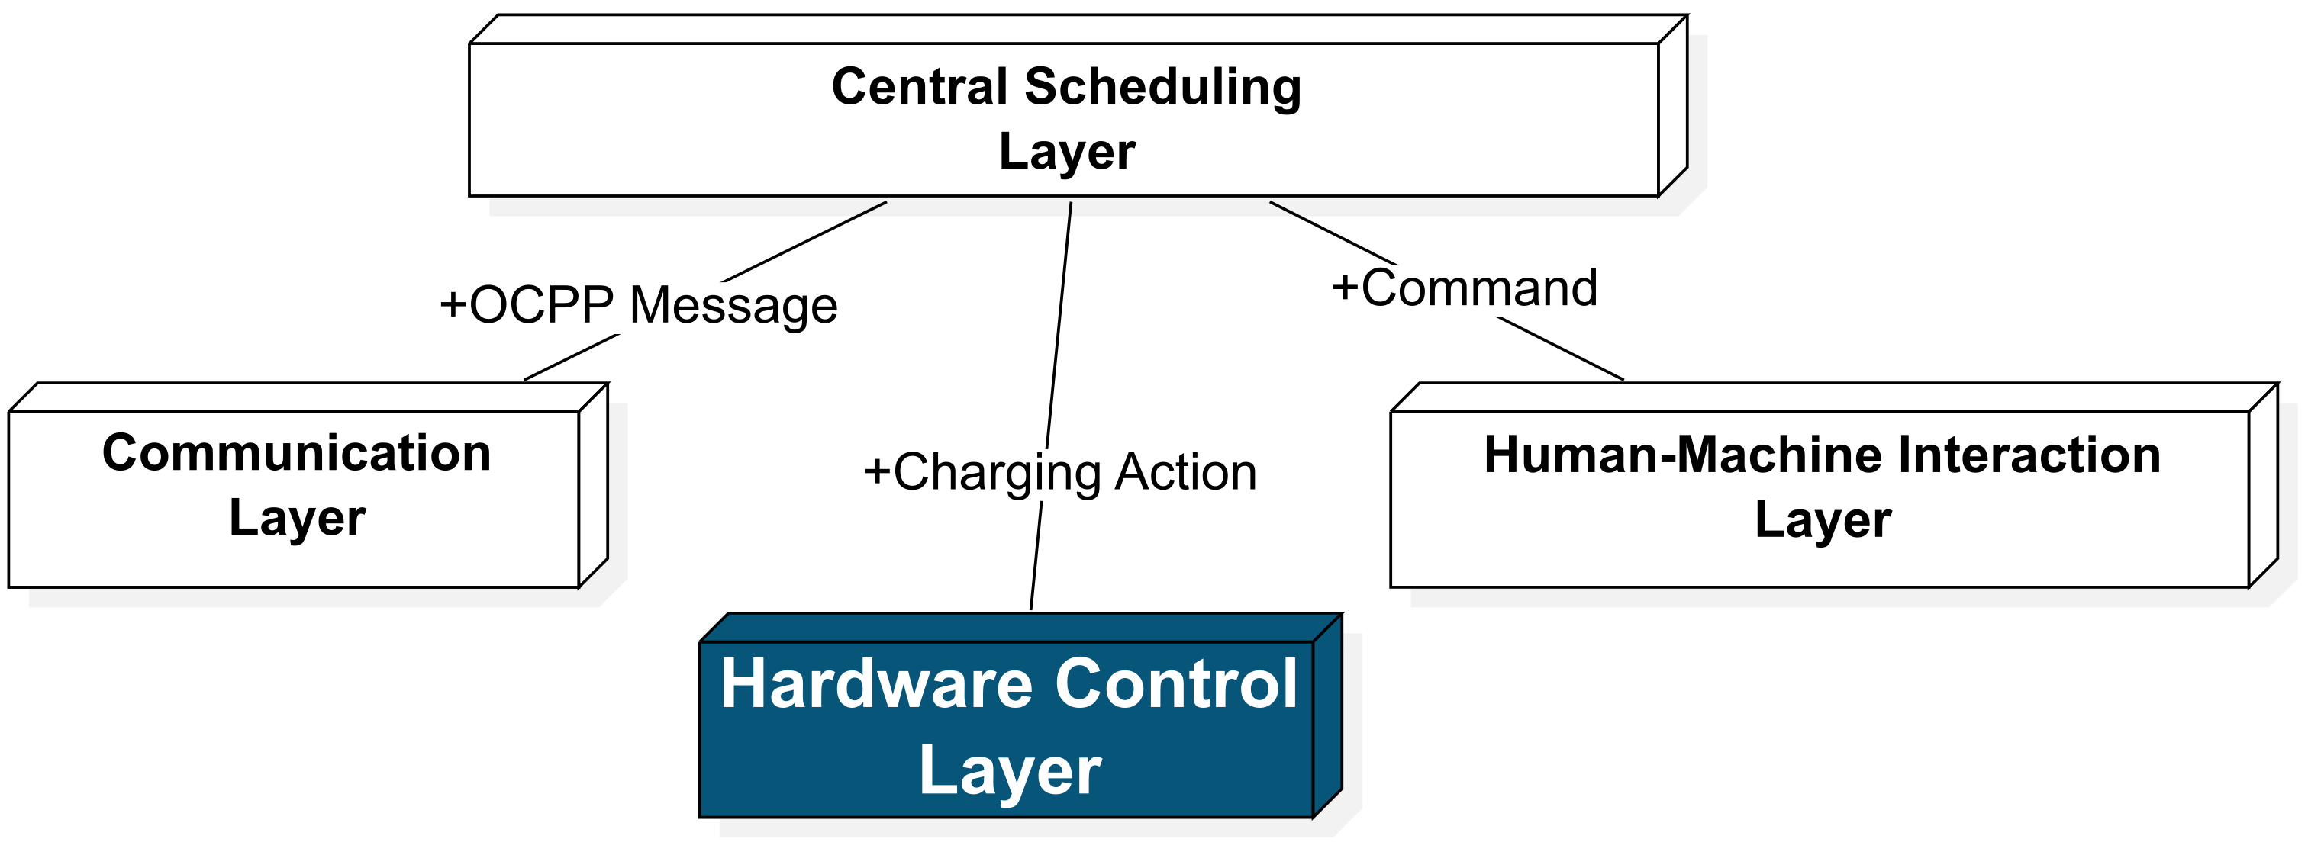
System structure——Hardware Control
GPIO Management
LED Management
Sensor Polling
Data Management
Charging Unit
Notes:
Next is a very important module--GPIO Module. It has five main parts: GPIO Management, Charging Unit, LED Control, Sensor Polling , and Data Management.

Slide 6
System structure——Hardware Control
GPIO Management Module
Top-level Module
Support multiple charging ports (evse, shelly, latch motor)
Notes:
The GPIO Management Module is the top-level module that manages all other modules. It supports multiple charging ports.

Slide 7
System structure——Hardware Control
Sensor Polling
Data collection
Data Management
Error —> Stop Charging
Charging Unit
For Safety
Collect data at regular intervals
Check error
Notes:
The Sensor Polling collects sensor data at regular intervals and sends this data to the Data Management Module. This includes vehicle status, EVSE status, charging current, power, and charged energy. If a sensor error occurs, this module notifies the Charging Unit Module to stop charging for safety.

Slide 8
System structure——Hardware Control
LED Control & Data Management
Singleton
Display status of Charging Station
Foundation for future database connections
Notes:
The LED Control and Data Management use the singleton. They manage the LEDs of the charging station and all global hardware data. This allows the GUI to display real-time data and provides a foundation for future database connections.

Slide 9
System structure——Hardware Control
Execute
Charging
Logic
Stop
Charging
Trigger of Correction
of
Charging
Schedule
Modbus Communication
with EVSE
00
Notes:
The most important part of GPIO is the Charging Unit Module. Its main tasks are to execute charging logic, stop charging, trigger the correction of the charging schedule, and handle error signals from other modules. Charging and stopping are executed by communicating with the actuator using Modbus. When an error occurs, the charging station stops charging immediately and unlocks the charging port.

Slide 10
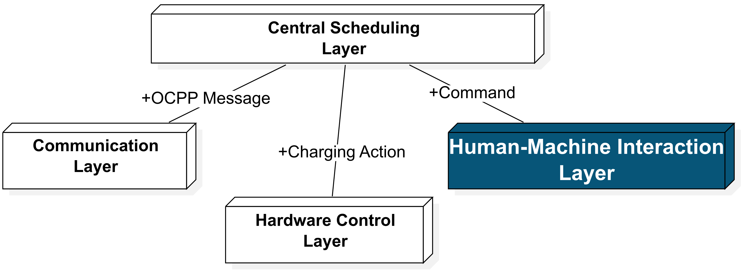
System structure——GUI
GUI Communication is executed by setting up a server.
Users can control the charging station through a web page.
Notes:
GUI Communication is executed by setting up a server. Users can control the charging station through a web page. This part will be explained by my teammate later.

Slide 11
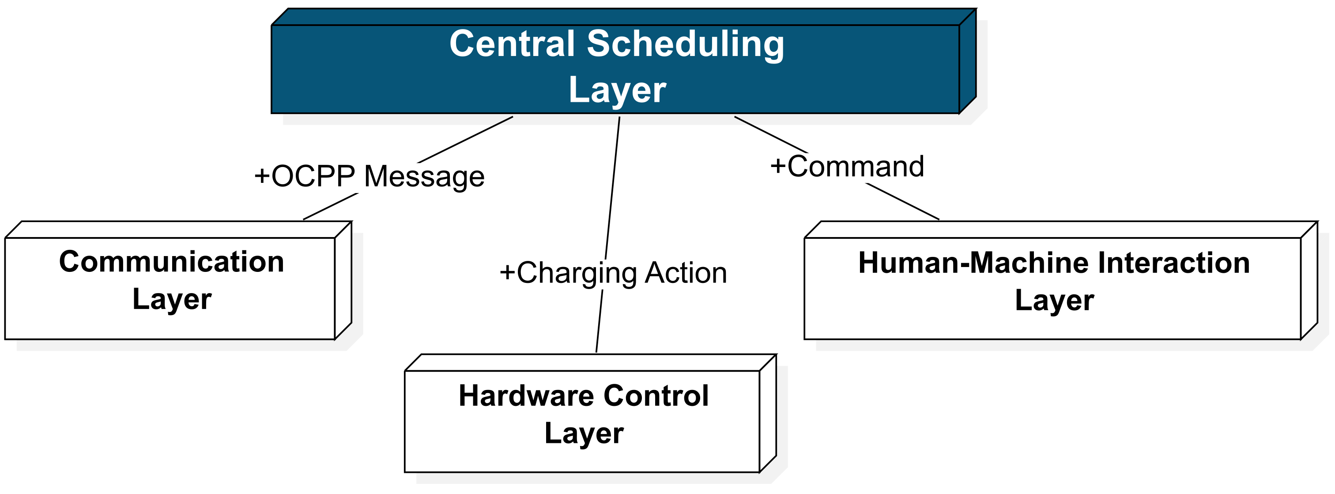
System structure——Central Layer
The Central Scheduling Layer
The Central Scheduling Layer
connect all modules
manage task scheduling
Notes:
The Central Scheduling Layer is used to connect all modules and manage task scheduling.

Slide 12
System structure——Signal
Problem
Complex function calls
Solution
Create Signal class to decouple
Notes:
Because this system has complex function calls, we use signals to decouple the system. Compared to callback functions, signals are more flexible. We created a signal class referencing to Qt Signal. This is one of the highlights of our system.

